Slide 1
May 20, 2020 Flex20 Task Force
Office of Public Instruction Staff
Location: Zoom Meeting

Slide 2
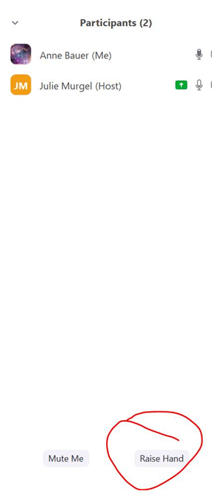
Task Force Member Participation
OPI encourages the task force members to participate in discussion:
Raise Your Hand
Participants>Raise Hand
Identify Yourself in the Chat (Full Name)
Comment in the Chat

Slide 3
Zoom Meeting Rules
This meeting will be recorded.
Conducted virtually due to social distancing guidelines currently in effect in Montana.
When speaking, please identify yourself and speak clearly.
You may be asked to repeat your comments or questions if there is a delay or issue with the audio.

Slide 4
Session 1 Outcomes
To launch the Flex20 Task Force;
To share the purpose, process, and deliverables of the task force;
To initiate the discussion on flexibilities; and
To outline next steps and off-line work prior to the second session.

Slide 5
Agenda
Welcome/Introductions
Purpose of the Task Force
Key Deliverables
Key Issues
Proposed Work Process
Communications Plan
Operating Logistics
Introductory Discussions
Next Steps

Slide 6
Welcome/Introductions
You will be placed in small groups in Zoom Break-Out Rooms:
A box will appear on your screen to join the break-out group. Press “join.”
At the 4 minute mark—a 60 second warning will appear that the session will be ending.
At 5 minutes, you will automatically rejoin the whole group.
In the Break-out room, introduce yourself and answer this question:
Question: Where are you from? How do you think that has influenced who you are?

Slide 7
Flex20 Task Force Purpose
Why have we been pulled together? What is the overall purpose?
To focus on flexibilities that promote opportunities for student success.
To clarify and communicate existing policy flexibility.
To consider potential waivers in key policy areas to enhance learning experiences as our schools prepare for the Fall of 2020.
Notes:
Notes: The current state and federal policy environment was built to service a more traditional school model. The COVID-19 pandemic has highlighted the various forms of friction between what educators need to enable and empower continuity of learning and what policy encourages or allows. Flexibilities provide relief from state and federal policies and regulations that put-up barriers. Flexibilities allow students to keep on learning and educators to rethink and transform education, drive meaningful change, build capacity, and support student health and well-being.

Slide 8
Key Deliverables
What are the critical documents or outputs that the Task Force must create to meet its charge?
At the end of the 3 sessions, each of the 5 focus groups will provide a list of recommendations to the Superintendent of Public Instruction for immediate consideration.

Slide 9
Flex20 Task Force Process and Timeline
What is our process?
Host 3- one hour sessions: 5/20, 6/3, and 6/10
Break-out into 5 focus area groups:
Strengthening Existing policy flexibility
Evaluating progress and impact of state graduation, credit, funding, licensure, and accreditation policies
Maximizing flexibilities in assessment, accountability and reporting systems
Fostering and supporting local innovation
Leveraging Federal Flexibilities and Resources
Between meetings, task force members will research, gather input, and reflect on essential questions for identified focus areas.
Collaborate on recommendations for the Superintendent of Public Instruction for immediate consideration and rapid response.
Who is responsible for doing what? What are our resources and constraints?
What are the key activities that must be done to address the issues, create the deliverables, and meet the charge?
A proposed list of steps is presented to use as a starting point for the task force.

Slide 10
Key Issues
What are the key issues that must be addressed in order to ensure that deliverables meet the charge?
In break-out groups host a discussion
Notes:
Use an interactive break-out group activity to allow the task force members to identify individual perspectives and hot buttons early in the meeting!

Slide 11
Communication Plan
Posted on the OPI Webpage under FLEX 20 Task Force Tab will be:
Meeting Minutes and Recording Links
Agendas
Materials: Presentations and Resource Tools
Focus Group Deliverables
Task Force Members will be emailed meeting minutes and the recording links.

Slide 12
Operating Logistics
The Schedule: When? Where?
Meeting Dates: May 20, June 3, June 10
Meeting Times: 11:00 a.m. – Noon
Task Force members are expected to attend all three sessions and actively participate.
Focus groups will determine deliverables through a consensus process.
Each focus group will identify a note taker to capture groups questions and decisions.

Slide 13
Meetings Norms
Focus on what matters
Contribute your thinking
Speak your mind and heart
Listen to understand
Link and connect ideas
Listen together for insights and deeper questions.

Slide 14
Introductory Discussion
Round 1:
What have we learned from COVID-19 regarding student learning?
What shifted from important to urgent?

Slide 15
Introductory Discussion
Round 2:
What current waivers have aided your district?
What waivers would help you if they were waived another year or permanently?

Slide 16
Introductory Discussion
Round 3:
What barriers do you still experience from the BOPE rules, the OPI, the US-DOE?
What would be beneficial to you if those barriers could be moved?
What methods of accountability make the most sense to you today?

Slide 17
Next Steps
1. Pick a focus area:
Strengthening existing policy flexibility
Evaluating progress and impact of state graduation, credit, funding, licensure, and accreditation policies
Maximizing flexibilities in assessment, accountability and reporting systems
Fostering and supporting local innovation
Leveraging federal flexibilities and resources

Slide 18
Next Steps
2. Review related policies, explore resources, gather input, and reflect on experiences relevant to the essential questions.
Consider barriers, potential legislative needs, regulation updates, and waiver requests.
Be prepared to discuss your findings and considerations at Session #2.

Slide 19

Thank you!
For questions or additional information please contact Julie Murgel at Julie.Murgel@mt.gov
Notes:
Are there any questions from this presentation?

